Slide 1
File handling

Slide 2
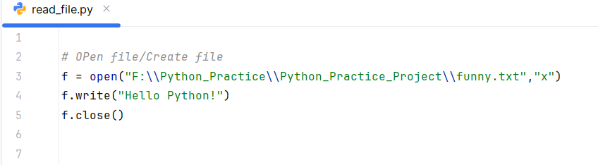
OPEN FILE

Slide 3
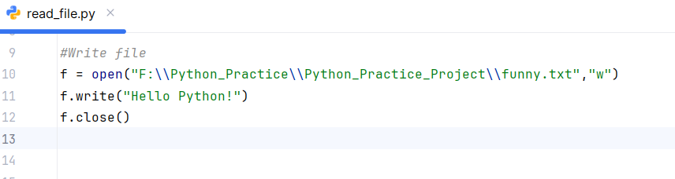
Write file

Slide 4
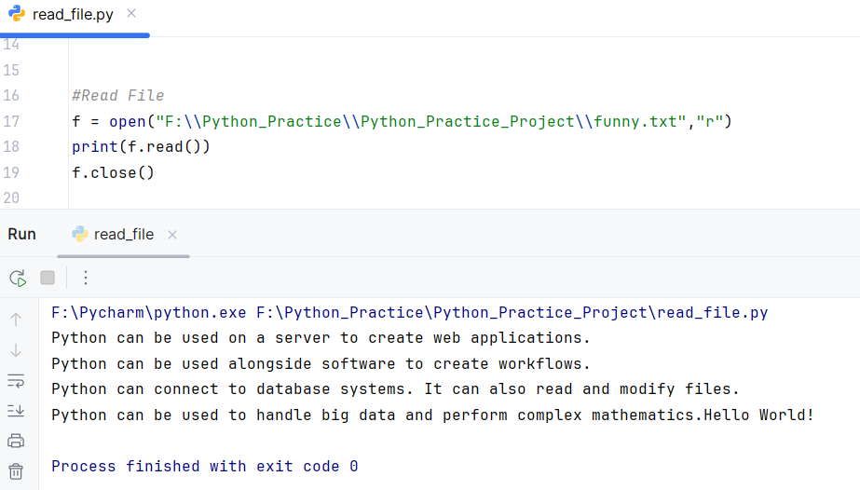
READ FILE

Slide 5
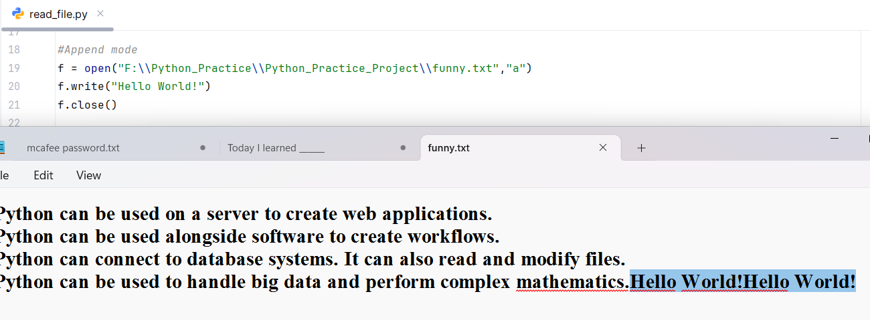
Append mode
Adds new content at the end

Slide 6
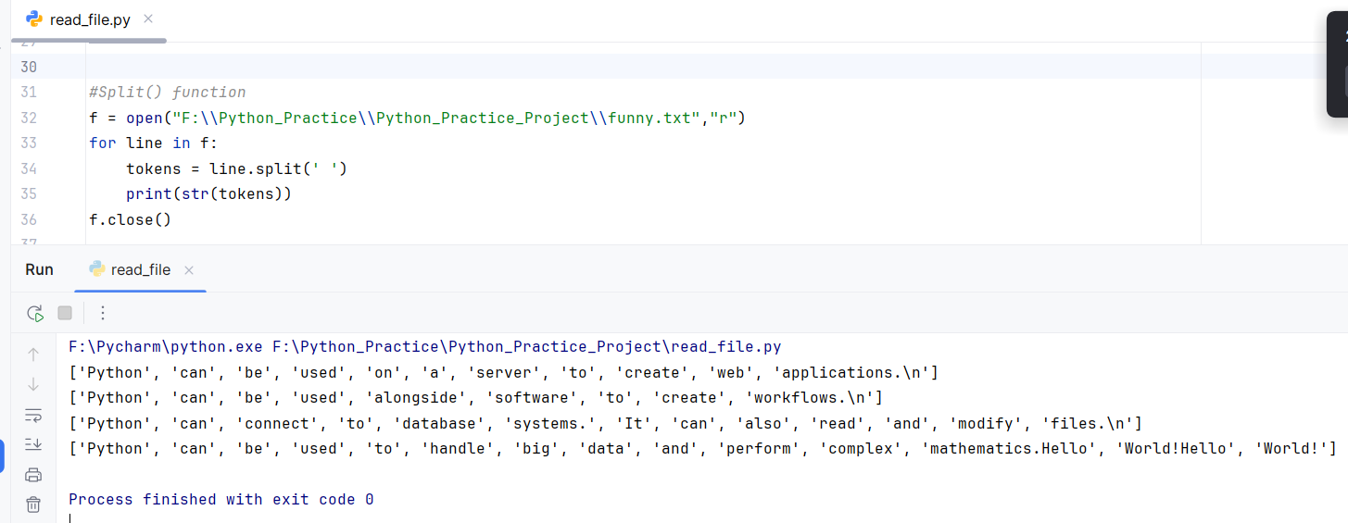
split() function
split() is a string method that breaks a string into parts based on a separator and returns a list

Slide 7
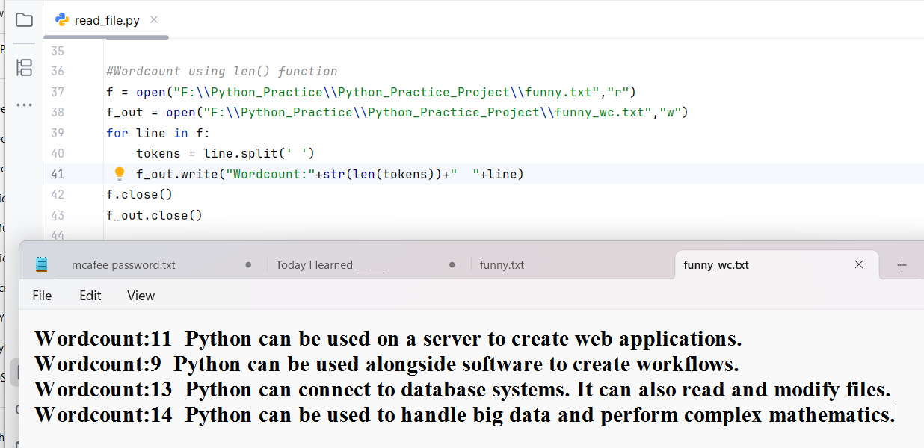
Count words of each line

Slide 8
File Handling Modes
Mode | Meaning
r | Read text file
w | Write text file
a | Adds new content at end
r+ | Read + Write
w+ | Write + Read
a+ | Append + Read
rb | Read binary
wb | Write binary
ab | Append binary
rb+ | Read + Write binary
wb+ | Write + Read binary
ab+ | Append + Read binary
x | Creates a new file

Slide 9
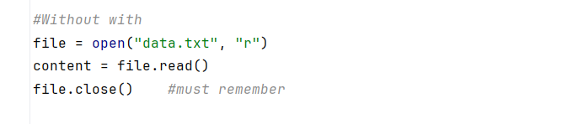
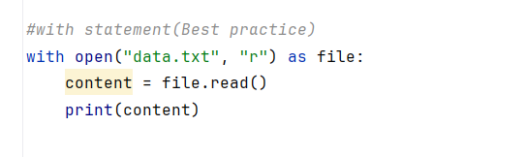
Why use with?
Without with:
You must manually close the file.
If an error happens before file.close(), the file stays open resource leak
With with (Best Practice):
Automatically closes file no need to write file.close()
Cleaner
Safer in case of errors

